Slide 1
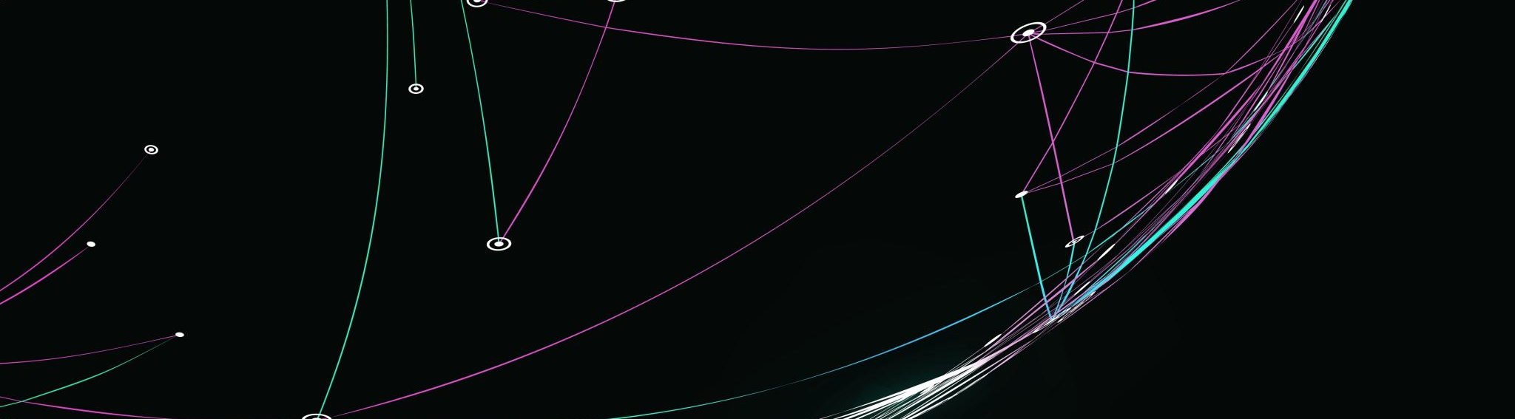
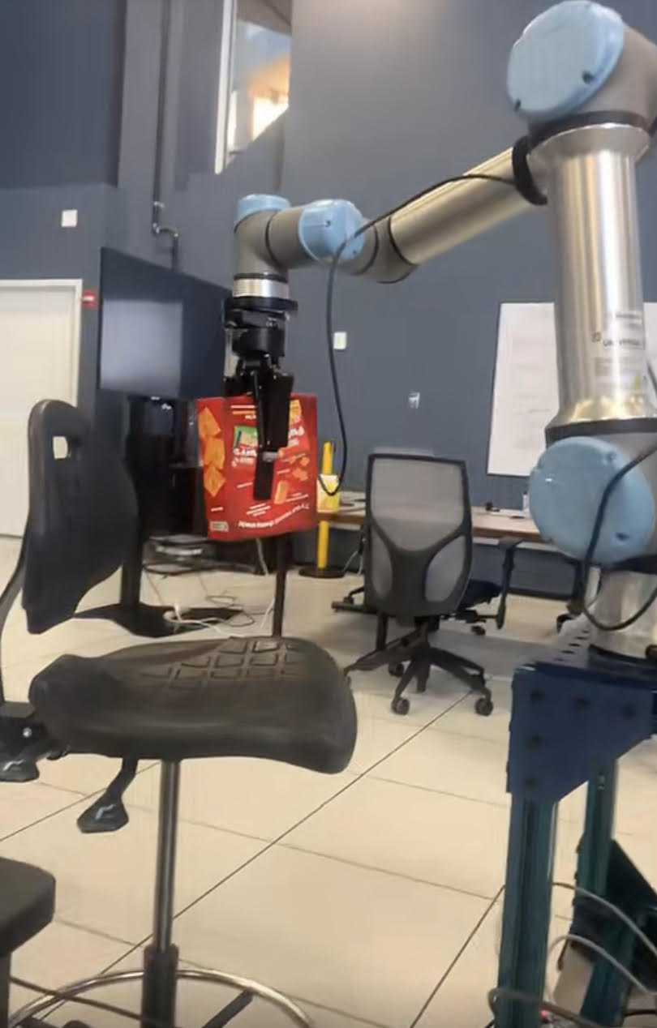
Updates:
-Installed a new battery pack for the raspberry pi
-Created a home location for the arm
-Activated the gripper
-Created a pick and place script using a box of cheez its
-Began testing example codes with Realsense USB camera such as ASCII reconstruction from depth frame capturing
Future goals:
Begin object detection and recognition using 3d point cloud of environment
Start Grasp planning to compute optimal grasping points on objects
Finish 3d prints around lab

